Slide 1

5th Floor, Usnaz Tower, Church Landing Rd, near Medical Trust Hospital, Pallimukku, Kochi, Kerala 682016

Slide 2
Python Variables

Slide 3
a variable is a named container for a particular set of bits or type of data (like integer, float, string ...
Variable_name = 555 (data)
Rules for creating variables in Python:
1. A variable name must start with a letter or the underscore character. 2. A variable name cannot start with a number. 3. A variable name can only contain alpha-numeric characters and underscores (A-z, 0-9, and _ ).

Slide 4
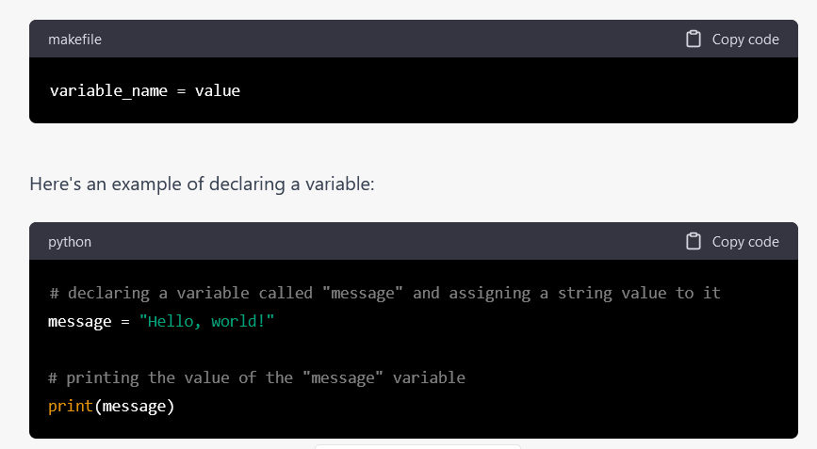

Slide 5
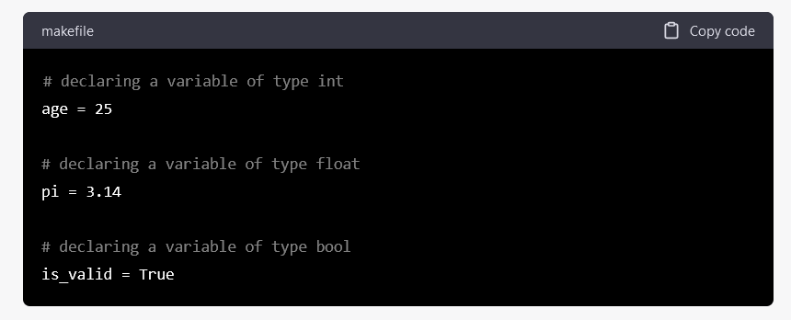

Slide 6
Case Sensitive
Variable names are case-sensitive. Example. a = 4 A = “hello“
print(A)
Variables - Assign Multiple Values
Python allows you to assign values to multiple variables in one line: Example x, y, z = "Orange", "Banana", "Cherry" print(x) print(y) print(z)

Slide 7
Output Variables
The Python print statement is often used to output variables. To combine both text and a variable, Python uses the + character Example, x = "awesome" print("Python is " + x)
You can also use the + character to add a variable to another variable: x = "Python is " y = "awesome" z = x + y print(z)

Slide 8
Multi Words Variable Names
Variable names with more than one word can be difficult to read. There are several techniques you can use to make them more readable: Camel Case Each word, except the first, starts with a capital letter: eg: myVariableName =”John”
John_Thomas =
Pascal Case
Each word starts with a capital letter: eg: MyVariableName=”John”
Snake Case
Each word is separated by an underscore character: eg: my_variable_name=”John”

Slide 9
Python Datatypes

Slide 10
Every value in Python has a data type.
Python Data Types are used to define the type of a variable. It defines what type of data we are going to store in a variable. The data stored in memory can be of many types.

Slide 11
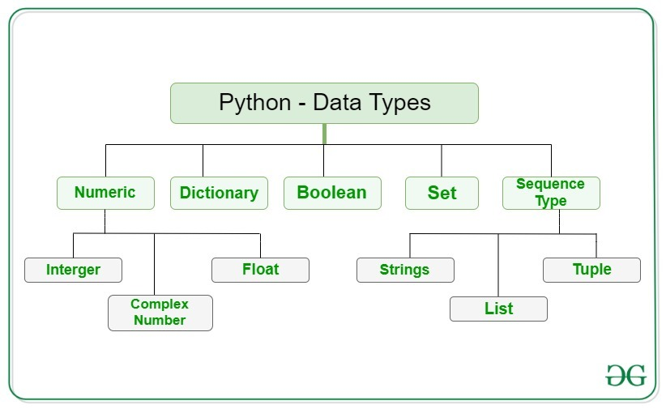

Slide 12
In Python, the data type is set when you assign a value to a variable:
Setting the Datatypes
Example Data Type
x=“Hello World” --------------------------------------- str x = 20 ----------------------------------------------------- int x=20.5 ---------------------------------------------------- float x=1j ------------------------------------------------------- complex x=[“apple”,”banana”,”cherry”] -------------------- list x=(“apple”,”banana”,”cherry”) ------------------- tuple x=range(6) ---------------------------------------------- range x={“name”:”John “,”age”:36} ----------------------- dict x={“apple”,”banana”,”cherry”} ------------------- set x=frozenset({“apple”,”banana”,”cherry”}) ------ frozenset x=True
X=False ----------------------------------------------------- bool x=b”Hello” ---------------------------------------------- bytes x=bytearray(5) ----------------------------------------- bytearray x=memoryview(bytes(5)) --------------------------- memoryview

Slide 13
Set: A set is an unordered collection of unique elements. Sets can be used to perform set operations such as union, intersection, and difference, and can be useful for removing duplicates from a list.
Dictionary (dict): A dictionary is an unordered collection of key-value pairs. Dictionaries can be used to store and retrieve data by a key, rather than an index, and can be useful for creating mappings and lookups.
Tuple: A tuple is an ordered, immutable collection of elements. Tuples can be used to group related data and are often used to return multiple values from a function or to create composite keys for a dictionary.
List: A list is an ordered collection of elements. Lists can be used to store and manipulate data in many ways and are often used as a general-purpose data structure.

Slide 14
Datatype Functions

Slide 15
String
Sequence of characters is known as strings.Strings are enclosed in "" Accessing elements by using string methods positive and negative multiline string elements are stored in triple quotes
Initialise a string, print the type, find the length.
A="bad","bed","bid","bud”
print(A)
print(len(A))
Concatenate 2 string and replicate first string in 2 times.
A="bad","bed","bid","bud"
B="bat","cat","fat","hat"
print(A+B)
print(A*2)
capitalise first character in a string, find uppercase and lowercase
B="cat"
print(B.capitalize())
print(B.upper())
print(B.lower())

Slide 16
Ordering using default arguments
#initialize a string value with format method and print the result
A="{},{},{}".format("abc","hij","qrs")
print(A)
Ordering using positional arguments
#Initialise string value with order and print the result
A=“{1},{2},{0}”.format("abc","hij","qrs")
print(A)
Ordering using keywords argument
Initialise key value strings and display the result
A="{s},{j},{c}".format(c="abc",s="hij",j="qrs")
print(A)

Slide 17
Set
A Set is an unordered collection of items. The elements are enclosed in{} Each items are seperated by using comma It can stored with mixed data It cannot generate duplicates but we can add and remove the data item from the set .
Initialise the set, find the type, add an item to a set, remove an item from the set.
A={2,4,6,8}
A.add(5) #adding
A.remove(2)
print(A)
Initialise 2 set, join the set by using union and find common element from the set and find the difference
A={2,4,6,8}
B={3,4,5,7}
print(A.union(B))
print(A.intersection(B))
print(A-B)

Slide 18
Dictionary
Dictionary is a type of mapping datatypes Enclosed in{} in a key:value format and each key value item is seperated by comma
Initialise a dictionary, print the type
Dict={"A":5,"B":7,"C":9}
print(type(Dict))
Initialise a dictionary, access all keys from a dictionary.
a={"A":5,"B":7,"C":9}
print(a.keys())
Initialise a dictionary, get a particular key value from a dictionary
Dict={"First_Name":"Rahul","Middle_Name":"Raphy”,"Last_Name":"MCA"}
print(Dict.get("Middle_Name"))

Slide 19
Initialise a dictionary, add an item to a dictionary
Dict={"A":5,"B":7,"C":9}
Dict["D"]=10
print(Dict)
Initialise a dictionary, update an item to a dictionary
Dict={"A":5,"B":7,"C":9}
Dict["C"]=10
print(Dict)

Slide 20
Tuple
Tuple is another type of data. It can be stored multiple elements/values in a single variable. These elements are enclosed in (). Each items have a specified order. The tuple elements are accessed by using index method. Tuple elements cannot be modified(unmutable).
Initialise with integers :
A=(2,3,4,5)
print(A)
Initialise tuple with mixed data :
A=(3,"Bat",0,5.6)
print(A)

Slide 21
Initialise tuple with more than tuple in a single variable :
A=((1,2,3),(6,2,3))
print(A)
Initialise a tuple, find 1st and 3rd last item from the tuple :
A=(5,7,3,9,4)
print(A[0],A[-3])
Initialise a tuple, find most repeated item in a tuple and index of tuple:
A=(3,6,9,12,15,6)
print(A.count(6))
print(A.index(6))
Initialise and delete a tuple :
A=(2,4,6,8)
del(A)
print(A)

Slide 22
Initialise 2 tuples, join and find replication :
A=(2,4,6,8)
B=(3,6,9,12)
print(A+B)
print(A*2)
Initialise a tuple and find an item is present in a tuple
B=(3,6,9,12)
print(6 in B)

Slide 23
List
List is a type of data. It can contain sequence or collection of data in a single variable.
The elements are enclosed in[] and the elemnts are seperated by using comma(,) The list items are ordered changeable(mutable) Each list item has specified position called index. They may be started with 0(positive indexing).
initialise a list and print the list, find the type and find total number of items in a list
A=[3,5,7,9]
print(len(A))
initialise a list with 7 values, find the 3rd item and 2nd last item from the list
A=[10,20,30,40,50,60,70]
print(A[2])
print(A[-2])

Slide 24
initialise 2 list, concatenate 2 list, display the replication of the 1st list
A=[5,10,15,20]
B=[3,6,9,12]
print(A+B)
print(A*2)
Initialise a list, insert an item at the 1st position of the list, add an item at the end of the list.
A=[2,4,6,8,4,4]
A.append(4)
#a.insert(‘index’,’value’)
A.insert(1,6)
print(A)
Initialise a list, remove an item from the list, then remove an item from 2nd position of the list
A=[2,4,6,8]
A.remove(6)
del A[1]
print(A)

Slide 25
Initialise a list, find the minimum and maximum element from the list and count the number of items repeated in a list.
A=[2,4,6,8,4,7,6]
print(min(A))
print(max(A))
print(A.count(4))
Initialise the list, Find the list items in ascending and descending order
A=[2,3,5,2,7,3]
A.sort()
print(A)
A.reverse()
print(A)
Initialise a list, Find sum of numbers in a list
A=[2,4,6,8,4,7,6]
print(sum(A))

Slide 26
Initialise a list, Find index position at the given number
A=[2,4,6,8,4,7,6]
print(A.index(4))
Initialise a list, Find an item is present in a list.
A=[2,4,6,8,4,7,6]
print(4 in A)

